Slide 1
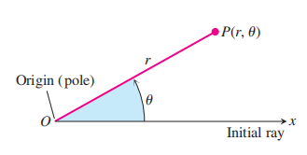


15.4 Double Integrals in Polar Form
Polar Coordinates

Slide 2

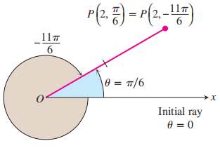



Sometimes we convent that or , then the points on the plane and the polar pairs are one to one.

Slide 3

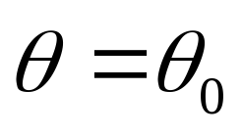
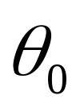
Polar Equations and Graphs
A circle centered at O with radius a
A directed ray started at O with the angle
counterclockwise from the initial ray

Slide 4
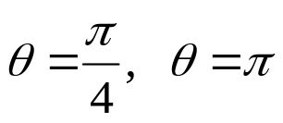
Example: (1) Graph the the equation r=1, r=2
(2) Graph the the equation

Slide 5
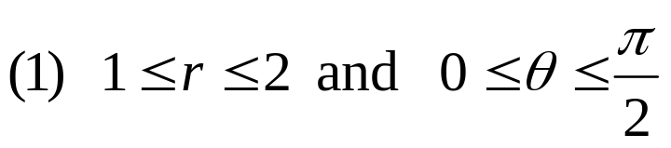
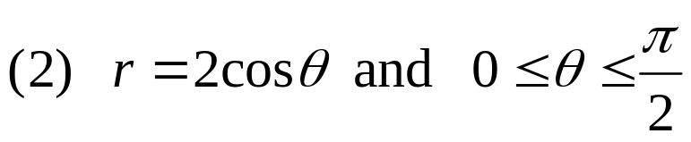

Example: Graph the sets of points whose polar coordinates satisfy the following conditions.

Slide 6
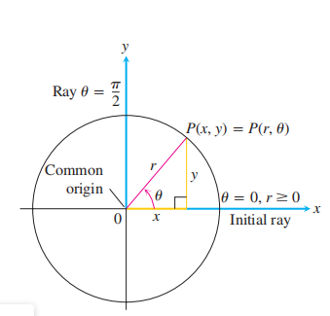

Relating Polar and Cartesian Coordinates

Slide 7
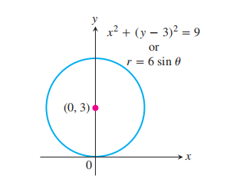

Slide 8


Slide 9

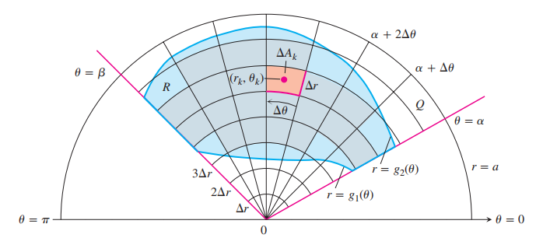
Integrals in Polar Coordinates

Slide 10
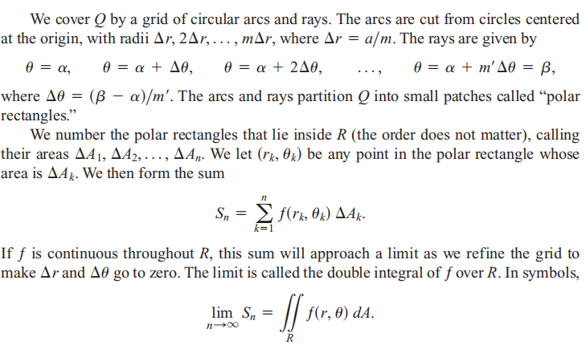

Slide 11
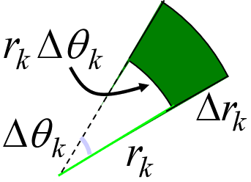
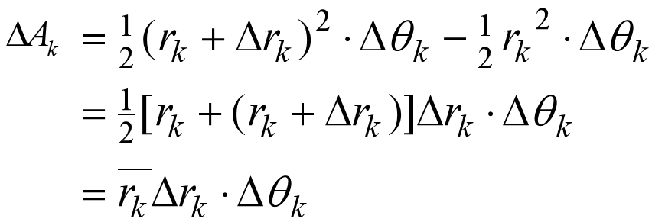


Slide 12



Slide 13
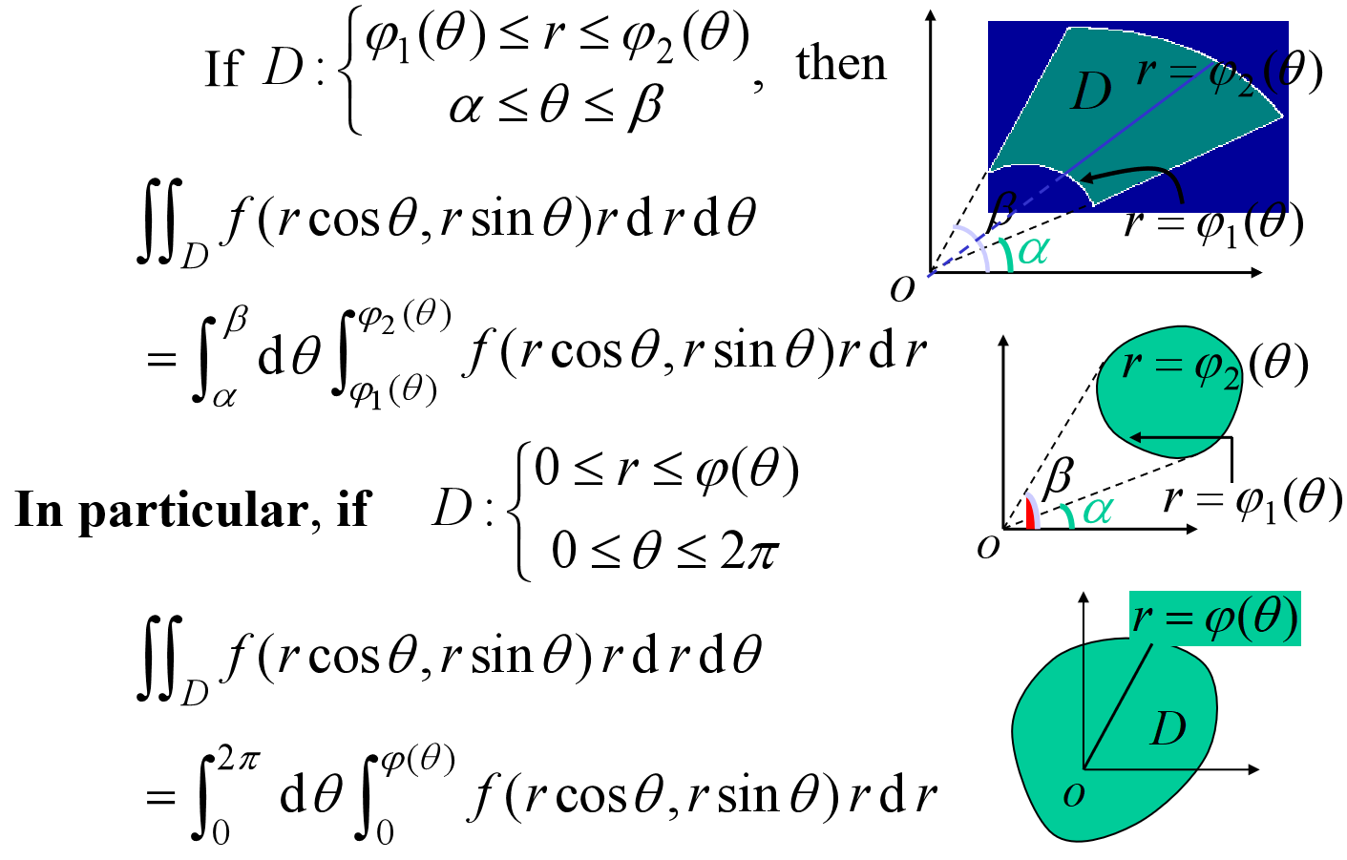

Slide 14
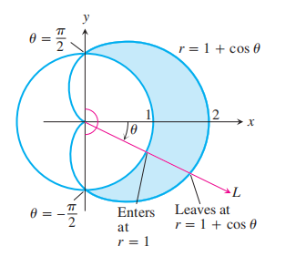

Slide 15

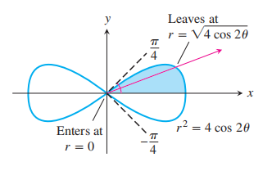

Slide 16

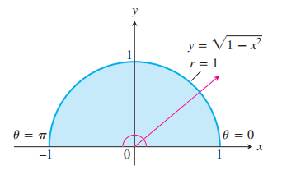

Slide 17


Slide 18
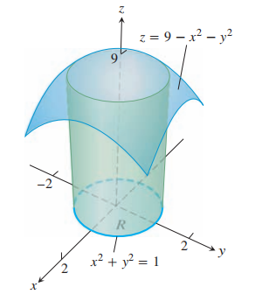

Slide 19
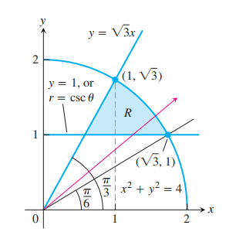

Slide 21


Example: Find where

Slide 23

Example：Change the Cartesian integral into an equivalent
polar integral and then evaluate the polar integral.

Slide 24


